Slide 1
Equality and Diversity
Notes:
1.30
Welcome to the Equality and Diversity Webinar
I will let you all see each other for introductions, but then please can your turn both your camera and your microphone off.
There will be times that I ask you to turn your microphone back on - for a discussion point, or you can use the text chat function.
There will be other times when I ask you to type in thoughts or questions on the text chat function.

Slide 2
Welcome and Introductions
Notes:
Welcome – trainer to introduce themselves
We will be going through this without a break, as it will last less than an hour
Ask group to introduce themselves – name, which organisation,
Poll = any previous E&D training?

Slide 3
Aims and Outcomes
To help you to understand protected characteristics and develop the confidence to address issues of equality and diversity in your job or volunteering role.
By the end of the session you should be able to:
Describe your duties regarding protected characteristics under the 2010 Equality Act and the 2011 Public Sector Equality Duty
Help celebrate people of all diversities and their achievements as part of your role
Notes:
Outline aims and outcomes of the session
Ask them to complete the first part of evaluation form – score their current level of understanding AND set an individual learning goal if they wish

Slide 4
What we’ll cover today:
Equality Act and protected characteristics
Discrimination and types of discrimination
Diversity
Unconscious bias
Embedding equality and diversity into your work
Notes:
Outline what will be covered during session

Slide 5
What is meant by Equality and Diversity?
Equality
Diversity
Ensuring that everyone has equal rights and opportunities
Removing barriers which people may face due to actual or perceived differences
Making sure everyone has the same access to employment and volunteering opportunities, goods and services
Ensuring that you value and respect differences between people
Recognising, valuing and taking account of different backgrounds, knowledge, skills and experiences.
Creating a diverse and productive workforce/ volunteer base
Notes:
1.40
On the text-chat – please write one or a few words that come to mind when you think about equality?
Ask group
What is meant by equality?
Then reveal answers.
Ask group – what is meant by diversity?
Then reveal answers.

Slide 6
Why is it important?
Legal requirement
Gives staff and volunteers the opportunity to fulfil their potential
Diverse organisation – failing to take advantage of a wider range of talents and skills can be costly for your organisation.
If you provide services to the public sector you are required to have E & D policies and to prove that they are implemented.
You can understand a broader range of your service users.
Will help you deal with any issues
Notes:
1.45
Outline slide

Slide 7
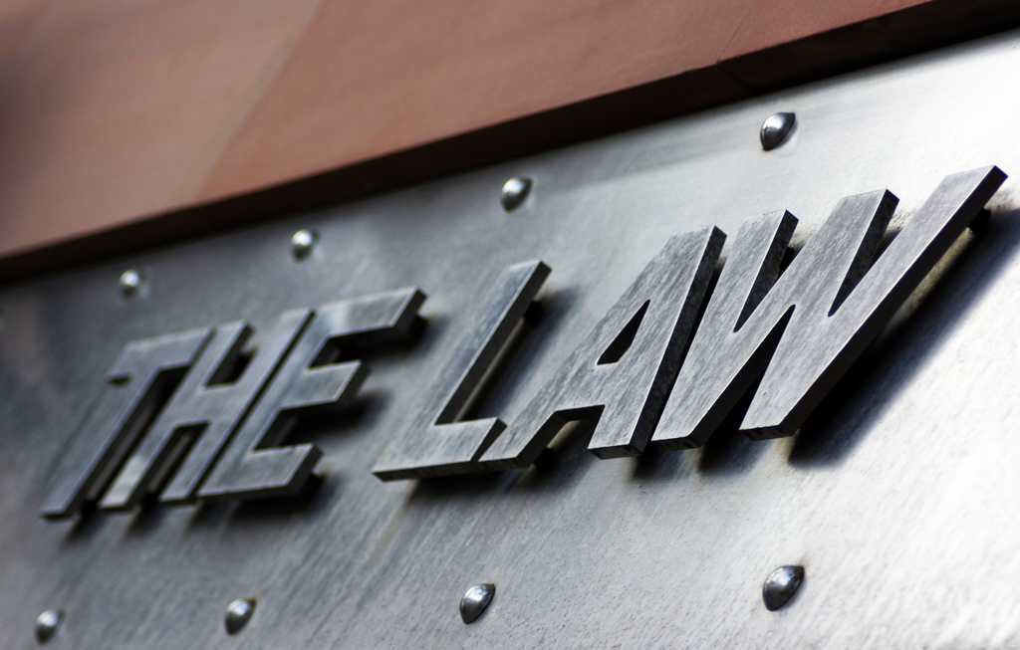
Legislation
Equality Act 2010
Public Sector Equality Duty
Notes:
Equality Act 2010
The Equality Act replaced most previous anti-discriminatory laws with a single Act to make the law simpler and to remove any inconsistencies/ambiguities. This made the law easier to understand and comply with. It also provided additional protection in some instances , e.g. for disabled people.
It aims to reduce unfair treatment:
In the workplace
When providing goods, facilities and services
When exercising public functions
In the disposal and management of premises
In education
By associations (such as private clubs)
The Public Sector Duty is part of the Equality Act - it ensures that public authorities such as local authorities, the NHS, police or schools must have ‘due regard’ or consciously consider or think about the need to do the 3 things:
Eliminate unlawful discrimination
Advance equality of opportunity between people who share a protected characteristic and those who don’t
Foster or encourage good relations between people who share a protected characteristic and those who don’t
Where a voluntary or community group provides a ‘public function’ then it is subject to the general equality duty , e.g if you have a contract to deliver a service with the Local Authority or with one of the CCG’s.

Slide 8
Protected Characteristics
The following characteristics are protected characteristics—
age;
disability;
gender reassignment;
marriage and civil partnership;
pregnancy and maternity;
race;
religion or belief;
sex;
sexual orientation
Notes:
1.50
At the heart of the Equality Act are the 9 protected characteristics:
Please turn your microphones on – now tell me if you know any of these?
These all apply to England, Wales and Scotland.
Age:
Age discrimination is where you are treated unfairly because of your age or because you are part of a particular age group
Disability:
A person is deemed to have a disability under the Act if they have a physical or mental impairment AND the impairment has a substantial and long-term adverse effect on their ability to carry out normal day-to-day activities.
Some impairments are automatically treated as a disability, e.g. cancer, visual impairments, multiple sclerosis, HIV, a severe, long-term disfigurement (e.g. facial scarring or a skin disease)
You have an ‘impairment’ if your physical or mental abilities are reduced in some way compared to most people.
An impairment does not have to be a diagnosed medical condition. If you are suffering from stress, you might have mental impairments – e.g. difficulty concentrating as well as physical impairments such as extreme tiredness and difficulty sleeping. Your impairment does not have to stop you doing anything, provided it makes it harder.
Gender reassignment:
You must not be discriminated against because you’re a transsexual person.
Gender reassignment for these purposes is a personal process rather than a medical one
A transsexual person is defined as someone who:
wants to change their gender, whether they go through with the medical treatment or not
has had a gender reassignment
is undergoing medical treatment to reassign their gender
has started the medical process but has decided to stop it
has decided to adopt the identity of their chosen gender without undergoing a medical gender reassignment
wants to dress as their chosen gender, all the time or only occasionally
Marriage and civil partnership:
You must not be discriminated against because you are married or in a civil partnership.
If you are separated you are still protected until your marriage or civil partnership is legally dissolved
Pregnancy and maternity:
Pregnancy and maternity discrimination is dealt with differently. If you’re in the ‘protected period’ you have greater protection. The ‘protected period’ runs from the start of your pregnancy to the end of your maternity leave. If you are not entitled to maternity leave, for example because you're an agency worker rather than an employee, the protected period ends 2 weeks after the birth.
It counts as pregnancy discrimination if you’re treated unfavourably because you are pregnant; have a pregnancy-related illness; are on maternity leave
It counts as sex discrimination if you experience unfavourable treatment outside of the protected period because you have a child. It’s also sex discrimination if an employer treats you less favourably outside the protected period because you have postnatal depression.
Race:
Race discrimination is when you’re treated unfairly because of one of the following things:
colour
nationality
ethnic origin
national origin
Religion or belief:
This covers discrimination because people have particular faiths and beliefs. Belief means both religious and non religious beliefs.
What is meant by religion?
Organized religions, e.g. Islam, Christianity, Judaism, Sikhism, Buddhism and Hinduism.
Religion also includes smaller religions or sects, e.g. Rastafarianism, Scientology or Paganism.
You can also be discriminated against because you belong to a specific denomination or sect within a religion ,e.g. Protestants, Methodists or Jehovah’s Witnesses within
You are also protected against discrimination under the Equality Act if you don’t belong to any religion or have any religious beliefs, e.g. Atheists
Sex:
Sex discrimination is where you are treated unfairly because you are a man or a woman. It applies to men and women of any age and ,therefore, includes girls and boys.
Sexual orientation:
You must not be discriminated against because you are gay, lesbian, bisexual or heterosexual.
This is different to gender reassignment – if you are treated differently because you are a transsexual person, this is discrimination because of gender reassignment.
It is also unlawful to discriminate because of the sexual orientation of someone you are with or someone you know. This could be a parent, child, partner or friend.

Slide 9
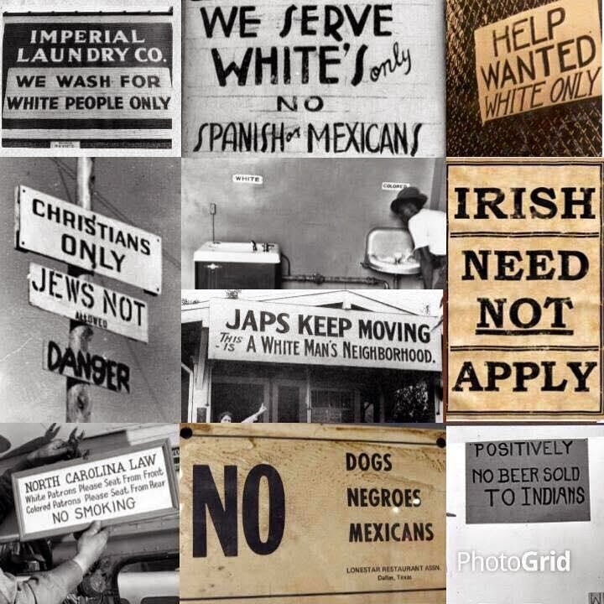
Fortunately times have changed
But have they enough?……
Notes:
2.00
How times have changed – show video – what a housewife must know – 1930s
https://www.youtube.com/watch?v=xcqjgQj6tJk
Seek feedback
There has been a surge in race crime since the Brexit Vote:
41% jump in reported racist or religious abuse incidents in the month after UK voted to leave the EU
By the end of that year (2016) the number of hate crimes overall had increased by 19% on the previous year.

Slide 10
What is discrimination?
Discrimination is the unfair treatment of an individual or group of individuals based on an actual or perceived characteristic – linked to the protected characteristics.
The Act defines five main types of discrimination:
Direct discrimination
Indirect discrimination
Harassment
Victimisation
Failure to make reasonable adjustments (by an employer)
Notes:
The Act defines five main types of discrimination.
We’ll now talk a little bit more about each of these in turn

Slide 11
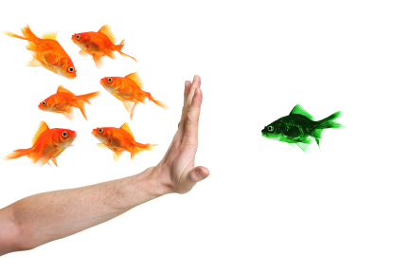
Direct Discrimination
Direct discrimination occurs when:
someone is treated less favourably than another person because of a protected characteristic they have or are thought to have (discrimination by perception) OR
because they associate with someone who has a protected characteristic (discrimination by association).
Notes:
2.10
Discrimination by perception- direct discrimination against someone because someone else thinks they may have a protected characteristic – for example discriminating against someone because they are perceived as gay because they wear a rainbow ribbon. The individual doesn’t have to possess the protected characteristic the person discriminating against them thinks they possess.
Discrimination by association – direct discrimination against someone because they associate with another person who has a protected characteristic. For example someone being subject to discriminatory remarks or bullied because they go for lunch everyday with someone who is a Muslim.

Slide 12
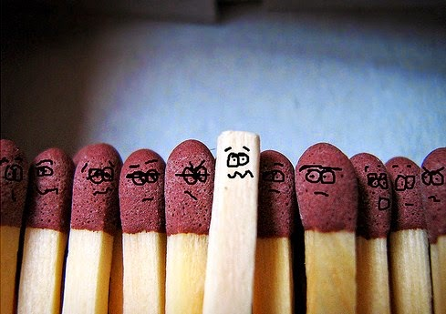
Indirect discrimination
Indirect discrimination can occur when a condition, rule, policy or practice in a company / organisation applies to everyone but particularly disadvantages people who share a protected characteristic.
Notes:
This may be justified if the employer/ organisation can show that they acted reasonably in managing their business/ organisation i.e. it is a ‘proportionate means of achieving a legitimate aim’
Example
An organisation sets an age restriction for volunteer drivers of over 25. This might be justified as driving is involved in the role and drivers must be over 25 for insurance purposes.
An organisation asked all staff to start earlier on a particular day for training purposes. This could particularly affect women who are mothers and usually take their children to school before they start work/volunteer. Can the organisation justify the timing of the training?

Slide 13
Harassment
Harassment is ‘unwanted conduct related to a relevant protected characteristic, which has the purpose or effect of violating an individual’s dignity or creating an intimidating, hostile, degrading, humiliating or offensive environment for that individual.’
It occurs because an individual possesses a protected characteristic.
It can consist of verbal abuse, racist jokes, insensitive comments, leering, physical contact, unwanted sexual advances, ridicule or isolation.
Employers have duty of care to employees to ensure they do not suffer from harassment within the workplace.
Notes:
Employers have duty or care to employees to ensure they do not suffer from harassment within the workplace – what about your volunteers?
Perception of harassment – in each case the victims perception of the behaviour is what makes it harassment not the intentions of the harasser (who will often claim it was a bit of fun!).
E.g. a male colleague addresses a female colleague as ‘love’ or ‘gorgeous’ – she has a right to complain and expect an apology and the stopping of that conduct
Others who are not the direct recipients of harassment can also complain if they find the behaviour offensive.
Bullying is not covered by the Equality Act 2010 – employers need a separate policy procedure.

Slide 14
Victimisation
Victimisation is when an individual is treated less favourably than others because they made , tried to make or supported a complaint of discrimination under the Equality Act.
Notes:
In order to be protected under the Equality Act the original complaint must have been made in good faith.
Someone making a malicious complaint or supporting an untrue one would not be protected.
E.G of victimisation – an employee who is gay is unhappy about a particular customer/service user who frequently makes homophobic remarks in front of him

Slide 15
Failure to make reasonable adjustments
When an individual has a disability employers have a duty to make ‘reasonable adjustments’ to the workplace to reduce the disadvantage that they could be facing.
For example: Altering a workspace to meet the needs of a person in a wheelchair.
Notes:
Ask group – what is reasonable adjustment?
When an individual has a disability, employers have a duty to make ‘reasonable adjustments’ to the workplace to reduce the disadvantage that they could be facing.
This is also good practice for volunteers ,but there is not a legal obligation or requirement to justify a refusal to take someone on in a role or make any changes to assist them deliver this role.
Good practice to enable volunteers to disclose any disability and support needs they might have – good practice to make those reasonable adjustments

Slide 16
Case studies
Direct discrimination
Indirect discrimination
Harassment
Victimisation
Failure to make reasonable adjustments (by an employer)
Notes:
2.20
Read out the case studies:
Mary is becoming the subject of discriminatory remarks and being hassled because she likes to go to lunch with Jude who is a Rastafarian. ​
Direct discrimination by association​
2) Macy is aware of rumours that she is gay as she likes to wear a pride badge and supports aids charities.
Direct discrimination by perception​
3) An organisation decides to run some of its projects on Saturdays. A staff member asks to be excused as he is Jewish and it is important to him that he observes the Sabbath. The organisation declines his request.
Indirect discrimination – can it be justified?​
4) Susan is not successful in the coordinator role at the charity as they assumed she is lesbian and that this might be an issue for some of the people she would have been managing.
Direct discrimination​
5) A charity decline to let John work in reception as he uses a wheelchair.
Direct discrimination​ /
6) Lucy has anxiety and her employer allows her to work slightly reduced hours to enable her to avoid rush hour traffic. Other staff complain that they still have to work 9 – 5.
Reasonable adjustment​
7) Jamila is Muslim and always wears a headscarf. The charity she works for introduce a complete ban on the wearing of headwear.
Indirect discrimination – can it be justified?​
8) Melissa’s male colleague addresses her as gorgeous – she dislikes it.
Harassment​
9) Margaret , aged 64, formally complained that she had been discriminated against because of her age This complaint was resolved but Margaret still senses animosity towards her and feels ostracised by management.
Victimisation
Which of these apply?

Slide 17
Unconscious Bias?
Everyone has unconscious biases. The brain receives information all the time from our own experiences and what we read, hear or see in the media and from others
The brain uses shortcuts to speed up decision making and unconscious bias is a by-product.
It's natural.
It's unintended.
It can affect decisions.
It can be mitigated.
Notes:
Ask - What do the group think ‘unconscious bias’ is?
Conscious thoughts are controlled and well reasoned. Unconscious thoughts can be based on stereotypes and prejudices that we may not even realise we have. E.g. stereotypes involving tattoos may subconsciously suggest a person is unlikely to conform and follow rules.
Show video- https://www.bing.com/videos/search?q=unconscious+bias+you+tube&&view=detail&mid=5492C3825FC3CD535DFA5492C3825FC3CD535DFA&&FORM=VRDGAR
How to overcome unconscious bias
Be aware of unconscious bias.
Be more self aware.
Don't rush decisions, take your time and consider issues properly.
Justify decisions by evidence and record the reasons for your decisions, for example during a recruitment exercise.
Try to work with a wider range of people and get to know them as individuals.
Focus on the positive behaviour of people and not negative stereotypes.
Employers should implement policies and procedures which limit the influence of individual characteristics and preferences.

Slide 18
Created by:
CVS Cheshire East
11 Hope Street
Sandbach
Cheshire
CW11 1BA
Office also in Crewe
enquiries@cvsce.org.uk
www.cvsce.org.uk
CVS Cheshire East
@cvsce @CVSCETraining

